Slide 1
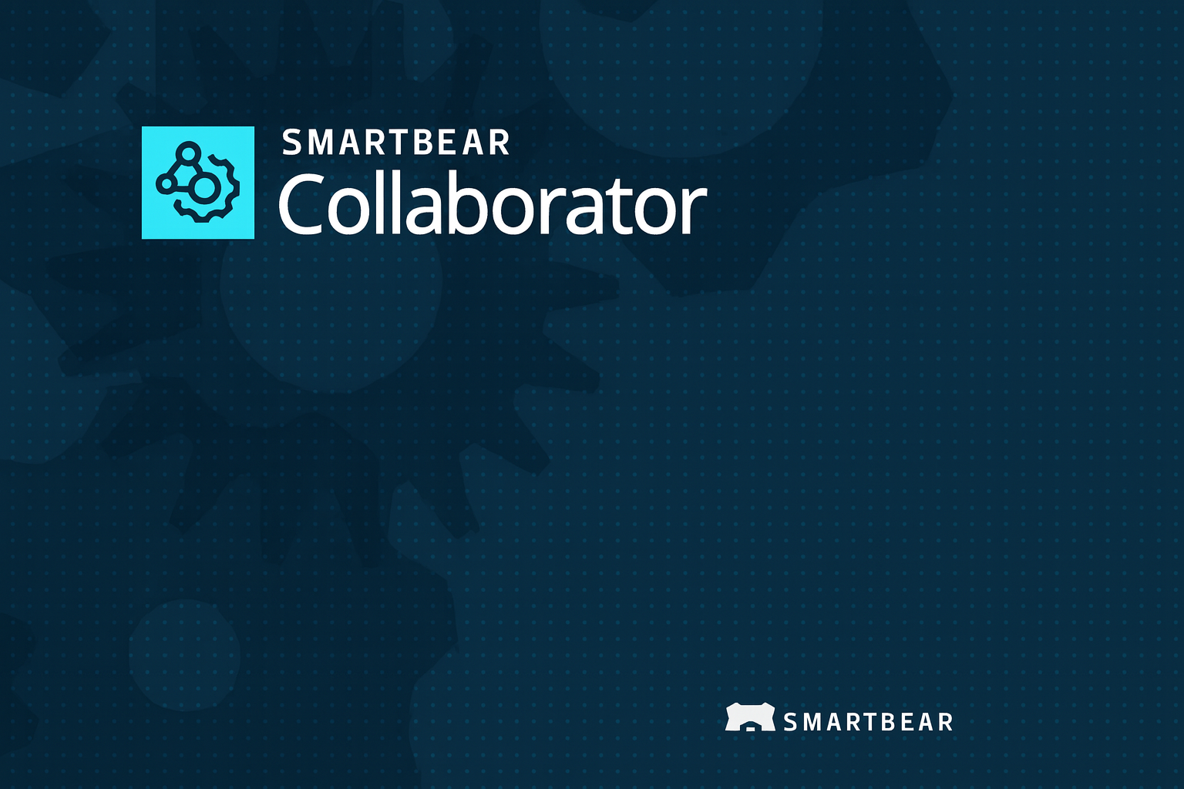

Slide 2
Contents
What is code review and why it matters?
Introduction to Collaborator.
Who uses Collaborator?
Why use Collaborator?
Core features and capabilities
Editions and Scalability
Integrations and Ecosystem
Supported Databases
Supported Integrations
Typical Workflow/How it works?
When and where Collaborator adds value?
Summary

Slide 3
What is code review and why it matters?
A systematic practice where developers review each other's code
Helps identify bugs early
Improves code quality and consistency
Reduces development time and rework
Code review matters as it:
Prevents defects before testing
Enhances team communication
Supports knowledge sharing
Proven to be the most effective QA strategy

Slide 4
Introduction to Collaborator
SmartBear Collaborator is a comprehensive code and document review platform designed to streamline this process. It brings developers, testers, business analysts, and managers together in a unified environment to review code, user stories, test plans, and documentation. With real-time visibility into changes and discussions, teams can detect issues early and maintain high development standards.
Collaborator supports rich integrations with popular version control systems, IDEs, CI/CD tools, and defect-tracking platforms, enabling seamless adoption into existing workflows. By fostering transparency and collaboration, Collaborator helps teams deliver reliable, high-quality software faster and more efficiently. To read more about Collaborator, please refer: https://support.smartbear.com/collaborator/docs/general-info/overview.html

Slide 5
Who uses Collaborator?
Developers
QA/Test Engineers
Business Analysts
Project Managers
Compliance/Documentation Teams

Slide 6
Why use Collaborator?
Unified platform for both code and document/artifact review — reduces scattered reviews, emails, and context switching.
Early bug and defect detection — reduces costs and delays down the line.
Consistent, auditable workflows and standardization via templates and checklists.
Greater visibility and collaboration among all stakeholders (dev, QA, design, docs, management).
Built-in metrics, reporting and audit trails — helpful for compliance, process improvement, and accountability.
Flexible integration with existing tools and version control systems — minimal disruption to existing workflows.

Slide 7
Core features and Capabilities
Supports many review styles — ad-hoc reviews, formal inspections, asynchronous reviews. https://support.smartbear.com/collaborator/docs/general-info/overview.html
Allows multiple simultaneous reviewers, useful when teams are distributed across time-zones. https://support.smartbear.com/collaborator/docs/general-info/overview.html
Source-control (SCM) integration with multiple systems (Git, Perforce, SVN, Mercurial, TFS, ClearCase, and more). https://smartbear.com/product/collaborator/features/integrate-with-11-scms/
Cross-platform clients: Web client, GUI client, command-line, and IDE plug-ins (e.g. for Eclipse, Visual Studio). https://support.smartbear.com/collaborator/docs/general-info/components.html
Support for reviewing a wide variety of file formats: code, Word docs, PDFs, spreadsheets, presentations, images, Visio diagrams — enabling document and artifact review beyond code.

Slide 8
Core features and Capabilities
Defect tracking: reviewers can mark issues, assign severity/type, classify defects, and integrate with external issue trackers. https://support.smartbear.com/collaborator/docs/general-info/overview.html
Customizable workflows: using templates, checklists, project/role-based rules to tailor the review process per team/project. https://smartbear.com/product/collaborator
Reporting & metrics: built-in analytics, exportable data, audit trails for compliance and process improvement. https://support.smartbear.com/collaborator/docs/general-info/overview.html

Slide 9
Editions and Scalability
Community Edition — lightweight, free for small teams / basic code review needs. https://support.smartbear.com/collaborator/docs/general-info/editions.html
Team Edition — for medium-sized teams needing more review features. https://support.smartbear.com/collaborator/docs/general-info/editions.html
Enterprise Edition — full-featured, supports advanced needs (e.g. complex artifact reviews like Simulink models). https://support.smartbear.com/collaborator/docs/general-info/editions.html

Slide 10
Integrations and Ecosystem
Integrates with many popular SCMs: Git, Perforce, Subversion, Mercurial, TFS, ClearCase, and more. https://smartbear.com/product/collaborator/features/integrate-with-11-scms
Works with many development environments and tools: IDE plugins (Eclipse, Visual Studio), GUI clients, CLI, web UI, making it flexible for different workflows. https://support.smartbear.com/collaborator/docs/general-info/components.html
Supports artifact/document review beyond code: Word docs, spreadsheets, PDFs, images, Visio diagrams — useful for requirement reviews, design docs, test plans, etc. https://support.smartbear.com/collaborator/docs/general-info/components.html
Supports custom integrations and automation via APIs, scripting, and web services — enabling extensions, automations, integration with issue trackers or reporting pipelines. https://support.smartbear.com/collaborator/docs/general-info/components.html

Slide 11
Supported Databases
Collaborator supports the following databases: https://support.smartbear.com/collaborator/docs/server/install/db/index.html
Embedded
MySQL
SQL Server
Oracle
MariaDB

Slide 12
Databases
Collaborator supports a built-in embedded (in-memory) database — useful for trials or quick setup without external DB configuration. https://support.smartbear.com/collaborator/docs/server/install/db/index.html
MySQL — Collaborator supports MySQL versions 5.6, 5.7, 8.0, and 9.0. https://support.smartbear.com/collaborator/docs/server/install/db/mysql.html
MariaDB — Collaborator supports MariaDB versions 10.6, 10.11 and 11.4 https://support.smartbear.com/collaborator/docs/server/install/db/mariadb.html
Microsoft SQL Server — Supported versions include 2012, 2014, 2016, 2017, 2019, 2022. https://support.smartbear.com/collaborator/docs/server/install/db/mssql.html
Oracle Database — Collaborator supports Oracle versions 11gR2, 12c, 18c and 19c. https://support.smartbear.com/collaborator/docs/server/install/db/oracle.html

Slide 13
Supported Integrations
Collaborator can be integrated with a number of source control integrations: https://support.smartbear.com/collaborator/docs/source-control/index.html
AccuRev
CVS
Git
ClearCase
Rational Synergy
Rational Team Concert
Mercurial
Team Foundation Server
PTC Integrity
Perforce
Subversion

Slide 14
Supported Integrations
Collaborator can be integrated with a number of Repository Hosting services : https://support.smartbear.com/collaborator/docs/source-control/repo-hosting/index.html
GitHub
GitLab
Bitbucket
Bitbucket Server (On-Premise)
Azure DevOps

Slide 15
Supported Integrations
Collaborator can be integrated with the following issue tracking services: https://support.smartbear.com/collaborator/docs/issue-tracking/index.html
JIRA(Cloud and on-premise)
TFS

Slide 16
Typical Workflow/How it works?
Developer (Author) creates a review — attaching code changes or documents.
Assign reviewers (could be multiple, across roles or time zones).
Reviewers inspect changes — comment, annotate, mark defects or suggestions.
Review can include multiple types of artifacts: code, docs, spreadsheets, diagrams, models.
Track defects, resolve or rework as needed.
Generate reports / audit trail — ensure review compliance, metrics, quality tracking.

Slide 17
When and where Collaborator adds value?
Teams working with multiple types of artifacts — code, design docs, requirements, tests, specs.
Distributed or remote teams — supports asynchronous reviews and multiple reviewers.
Projects needing compliance, audit trails, documentation, or strict quality control (e.g. regulated industries).
Organizations wanting to standardize review processes, enforce quality gates, reduce post-release defects.

Slide 18
Summary
Code & document review is vital for high-quality software and artifacts.
Collaborator unifies code + document reviews in a flexible, customizable tool.
Supports broad integrations, many file types, and scalable team needs
Helps catch defects early, improves collaboration, provides audit trails and metrics.
Flexible editions make it suitable for small teams to large enterprises.

